Slide 1
GitHub & LinkedIn: Your Digital CV
How to stand out in the job market
By: Abdul Rehman

Slide 2
RECAP
Section 1: The 3 C’s → Competition, Companies, CV
Section 2: What is Experience?

Slide 3
Competition
Category | Estimate (high-end/year)
Lahore CS degree holders | ~16,000
Other-city CS degree holders | ~9,000
Certificate / crash course entrants | ~25,000
Total Estimated Competition | ~50,000 CS/IT job seekers per year

Slide 4
Companies
Around ~880 registered software houses in Lahore.
With Unregistered small firms, 3,000+ software houses in Lahore
New Positions open based on Company Growth
Limited junior openings per year
Job switchers further decrease Opportunities
Companies want proof of skill, not just degrees

Slide 5
CV
Hardcopy CV = First impression
Digital CV = LinkedIn + GitHub
Recruiters Google you before shortlisting
Profile Stacking

Slide 6
What is Experience?
Experience = What is written or What can be validated ?
“5 years in Python” means nothing without proof
In the ChatGPT era → validation matters more than ever
How Experience is Validated
GitHub → Code, commits, projects = proof
LinkedIn → Endorsements, recommendations, employer tags = proof
Freelancing Profiles
Portfolio/Website → Public track record

Slide 7
CV Screening in the Modern Market
From job fairs to AI-powered applicant tracking systems
By: Abdul Rehman

Slide 8
Agenda
Section 1: What is CV Screening?
Section 2: Evolution of CV Screening?
Section 3: How ATS & AI ATS Work
Closing Checklist + Q&A

Slide 9
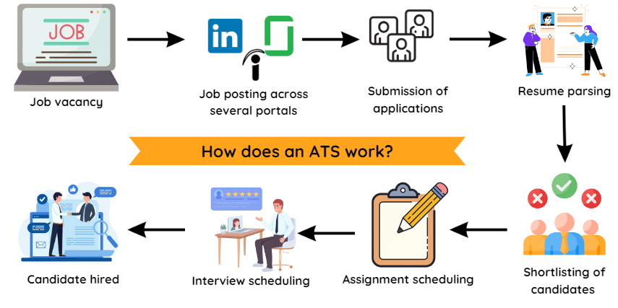
Hiring Workflow

Slide 10

Job Fair

Slide 11
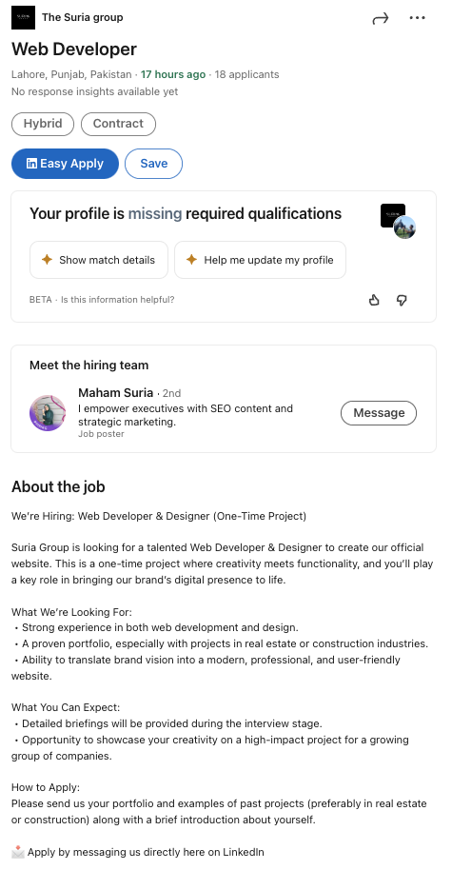
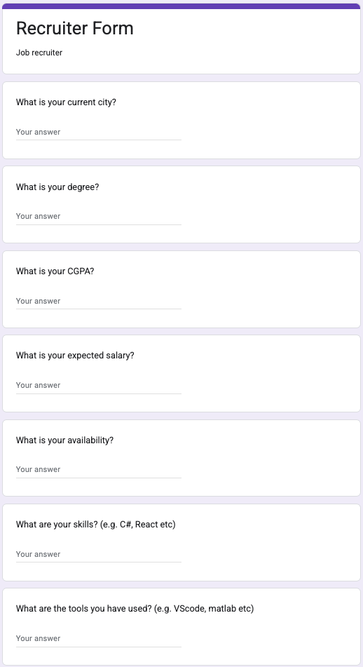
Online Form

Slide 12
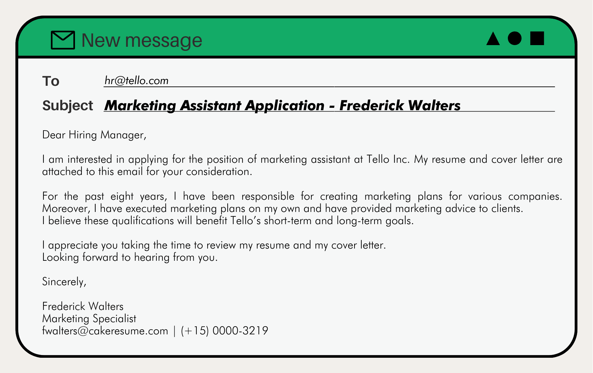
Email

Slide 13

Traditional Screening (Past)
Recruiters or HR assistants manually read through printed CVs
Screening focused on keywords (e.g., “BSCS”), job titles, or years of experience

Slide 14
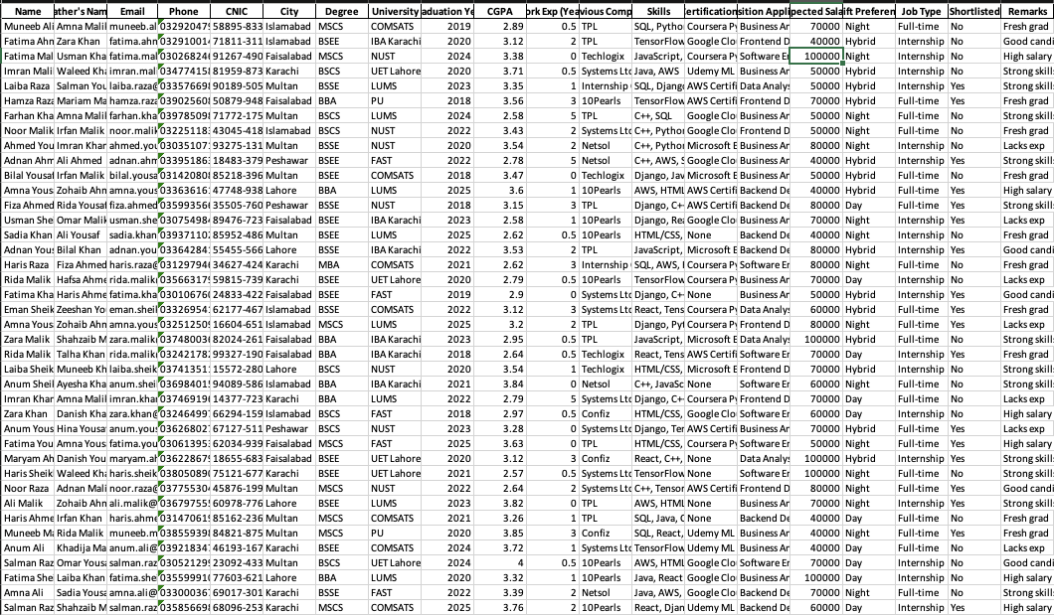
Excel Era (Mid-Sized Companies)
CV data was copied into Excel sheets for filtering.
Recruiters searched by degree, skills, or experience ranges.

Slide 15
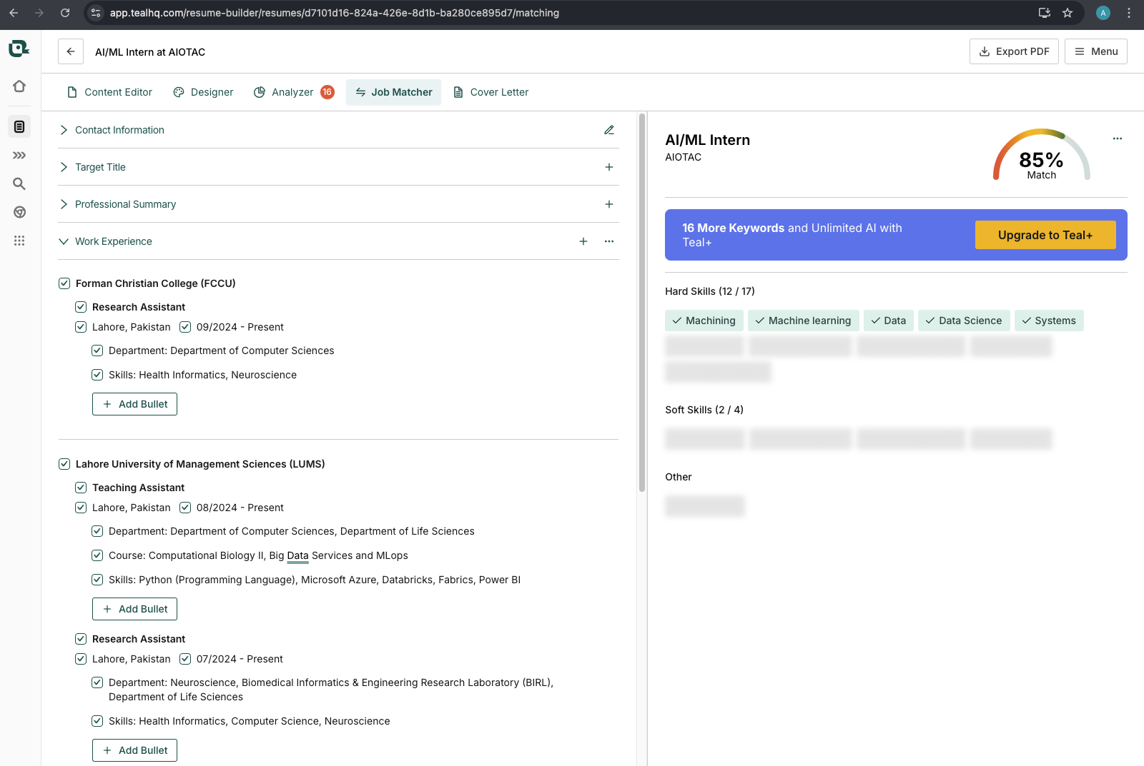
Modern Screening (Today)
Large companies and multinationals use Applicant Tracking Systems (ATS).
Many applications are filtered out before a human sees them.

Slide 16
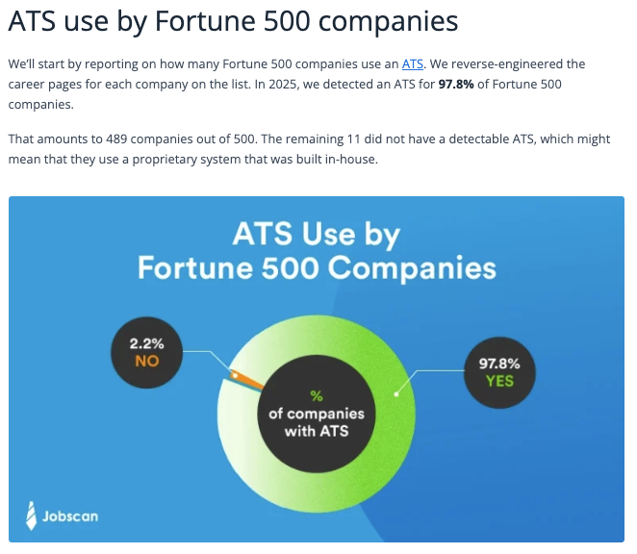
Source: https://www.jobscan.co/blog/fortune-500-use-applicant-tracking-systems/

Slide 17
How ATS Works
Parsing: Extracts CV text → Education, Skills, Experience.
Context Matching: Understands meaning, not just keywords. “Developed REST APIs in Django” ≈ “Backend development in Django.”
Scoring: Compares against job description.
Profile Health Score: Generates fit % or score bar.

Slide 18
Recruiter’s Workflow (Today)
200 CVs received.
ATS ranks & filters → top 20–30 shown.
Recruiter reviews shortlisted ones.
Top 5–10 move to coding test/interview.

Slide 19
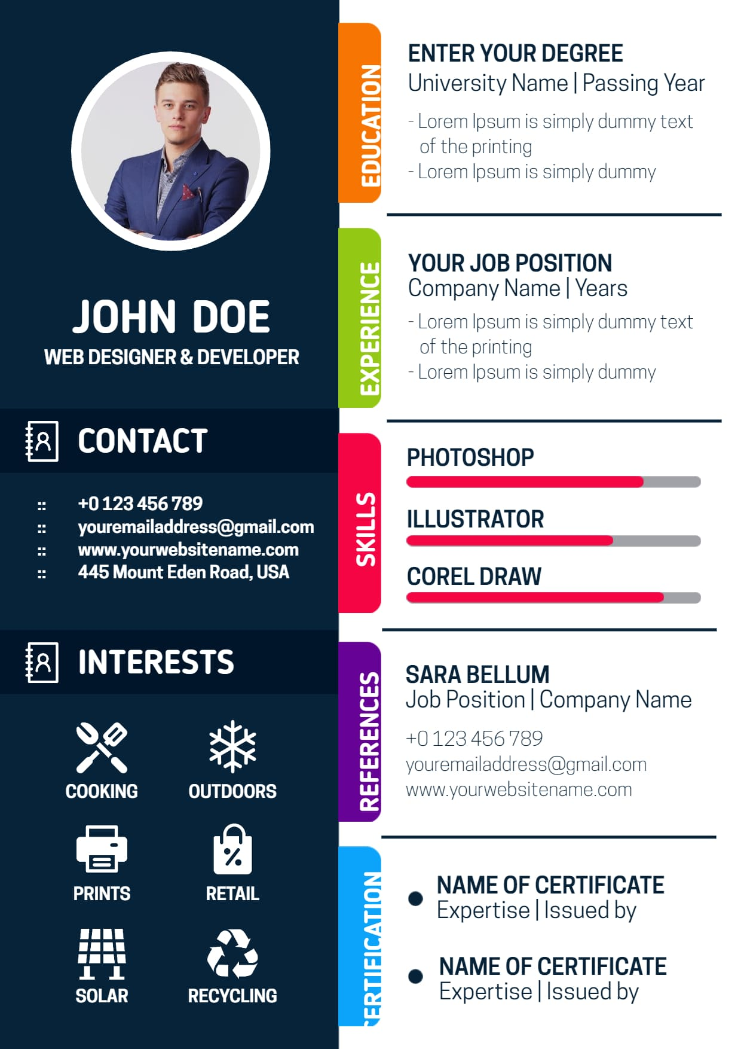
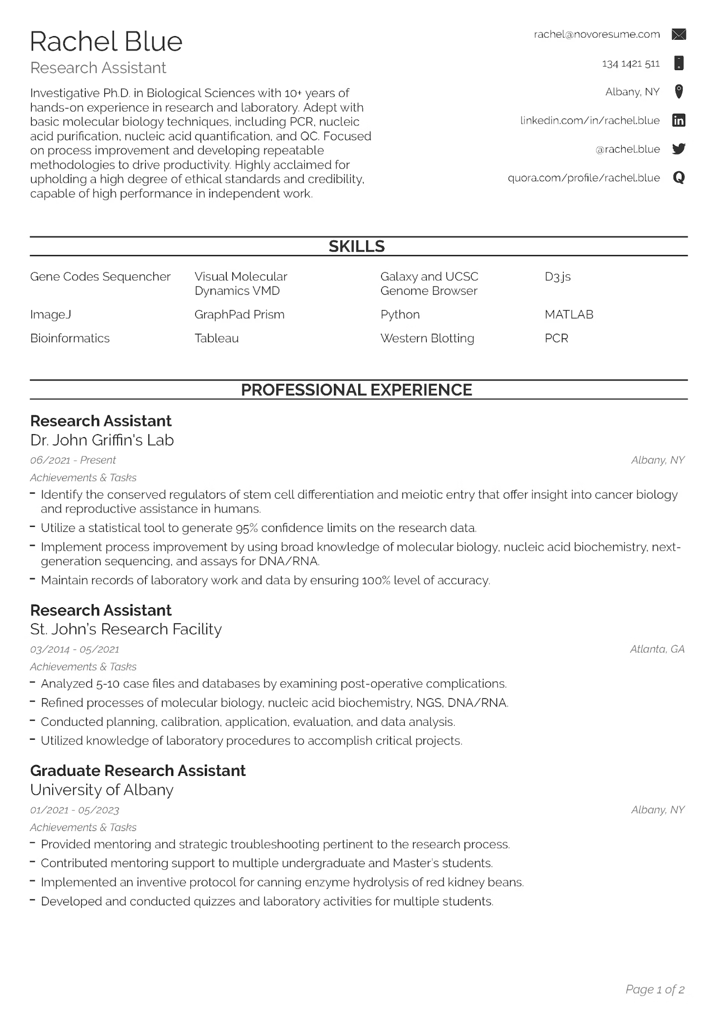
Impact of CV Formatting
CV with graphics, tables, or PDF columns might parse incorrectly.

Slide 20
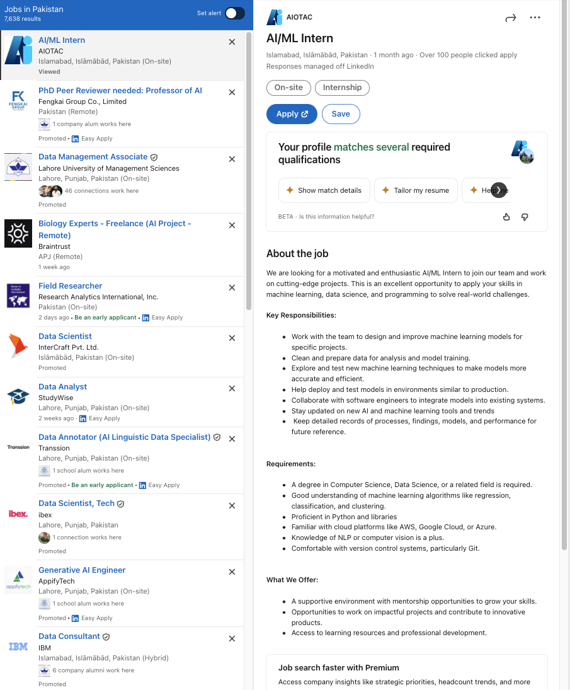
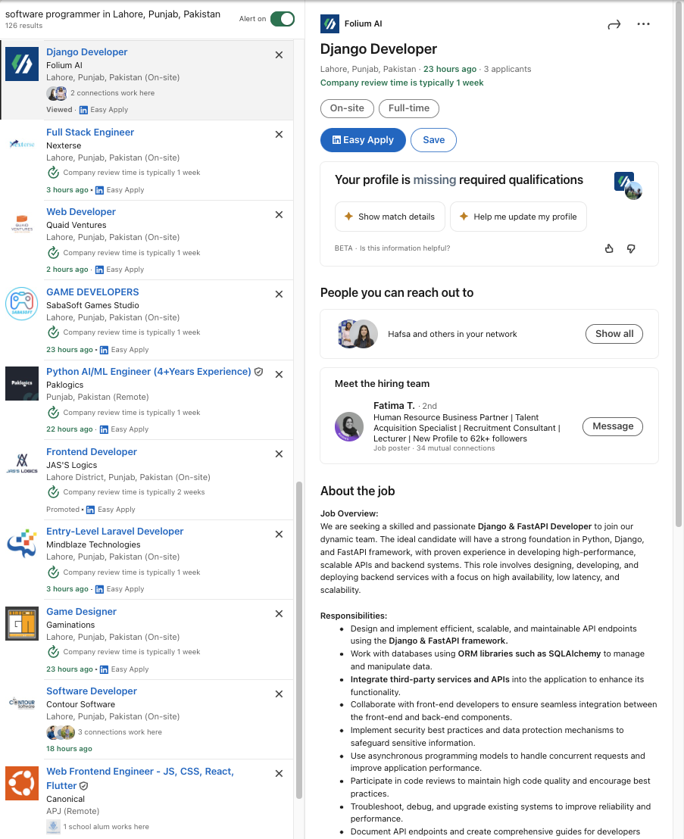
One CV, Different Job Descriptions

Slide 21
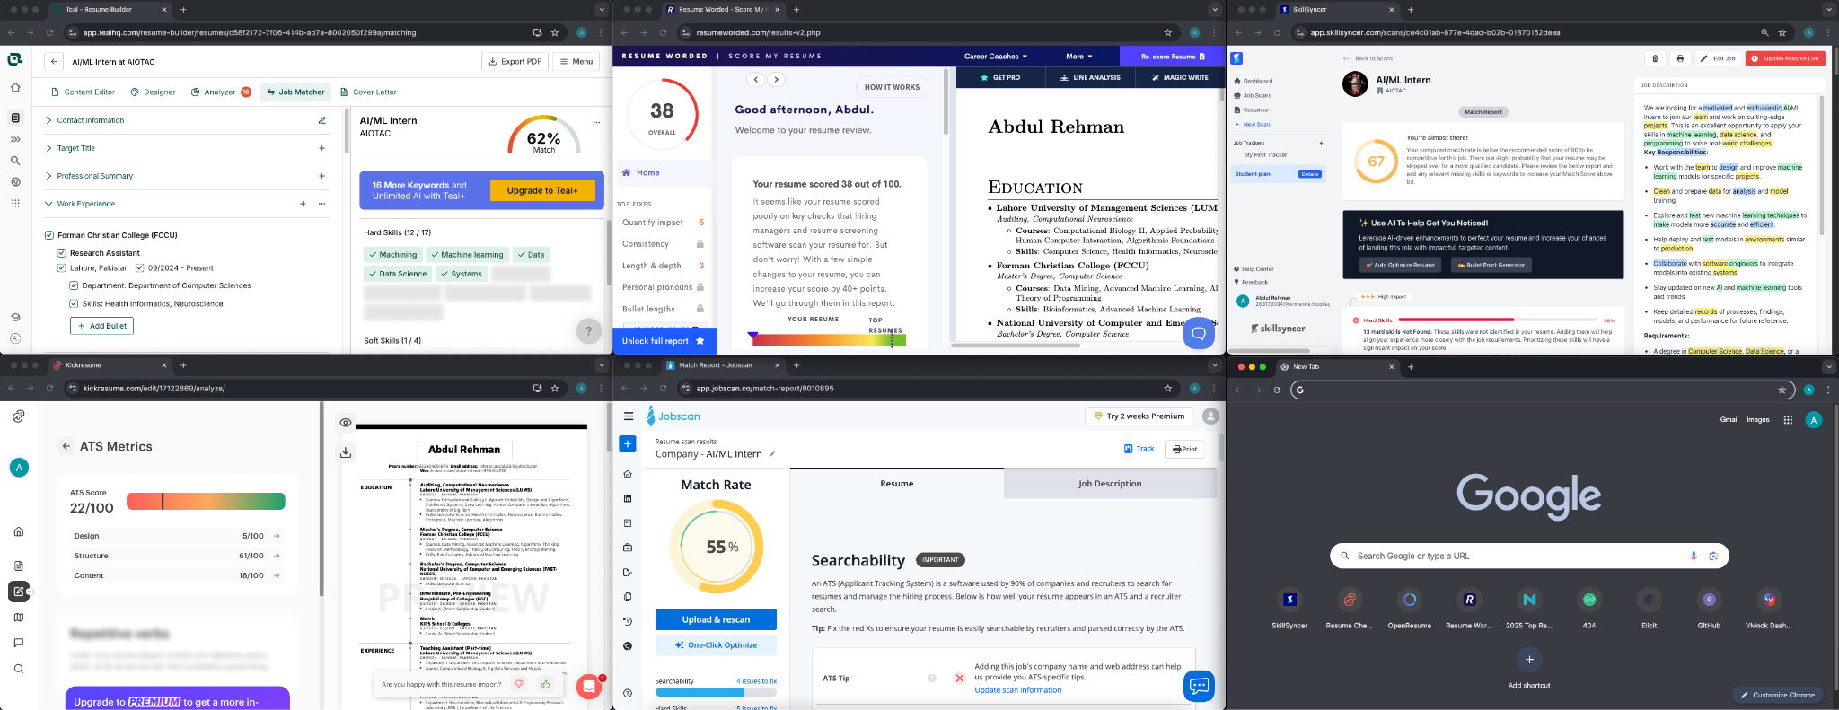
One CV, Different ATS Platforms

Slide 22
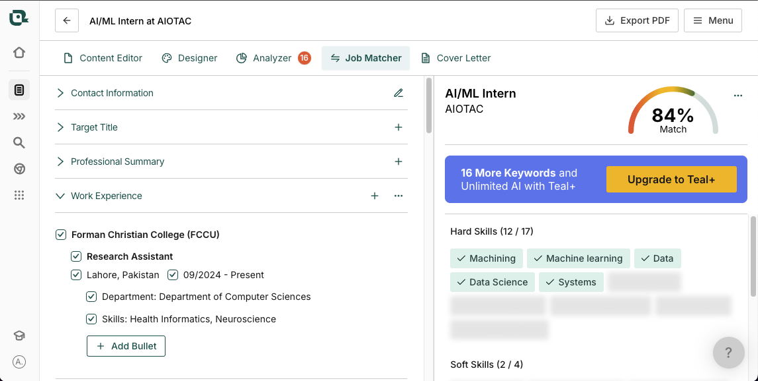
Keyword Optimization & Wording
how small wording changes affect matching

Slide 23
Adv. Intellegent ATS (2025 & Beyond)
Cross-Platform Profile Inference (GitHub + LinkedIn + Social Media) VIKI – Cross-Platform Profile Inference (Research Paper) https://arxiv.org/abs/2503.14772
Social Media NLP (for Personality / Behavior Analysis)
TweetNLP – State-of-the-Art NLP for Social Media https://arxiv.org/abs/2206.14774
GitHub Coding Skill / Activity Analysis
TopDev – GitHub Profile Analysis Tools https://topai.tools/s/github-profile-analysis
AI Recruiting / Talent Intelligence Platforms
Eightfold.ai (Uses skills-based matching, AI inference, bias-masking) Torre.ai (Professional genome: skills, personality, preferences, traits) Syman / Identified (Early AI that analyzed social profiles for recruiting insights) HireEZ (formerly Hiretual) (AI talent sourcing; aggregates GitHub + LinkedIn data)
Behavioral / Video AI in Hiring
HireVue – AI Evaluation of Video Interviews
https://digidai.github.io/2025/07/26/hirevue-deep-analysis/

Slide 24
Q&A
Any Questions?

